Slide 1
CSE 1001 Problem Solving and Programming
Dr. A. Nayeemulla Khan

Slide 2
Course Objective
Develop essential skills for a logical thinking to solve problems
Develop essential skills in programming for solving problems using computers

Slide 3
Outcomes
On completion of the course, students will have the
ability to identify an appropriate approach to solve a problem
ability to write a pseudo code for the identified strategy
ability to translate the pseudocode into an executable program
ability to validate the program for all the possible inputs

Slide 4
Session Plan
Core Python features required for problem solving - 31 Sessions that includes
5 Assessments
1 Challenging Task
Basics of ‘C’ language – 11 sessions that includes
1 Assessment
1 Challenging Task

Slide 5
Points to Ponder
Do not miss any class, practice problem, assessments and challenging tasks
Be ethical and professional throughout the course
Unethical practices are punishable

Slide 6
Continuous Assessment
8 Practice Sessions – 30 marks Weight age
10 Inlab Practice Sessions – 10 marks Weight age
6 Assessment Sessions – 40 marks weightage
2 Challenging Tasks – 20 marks weight age

Slide 7
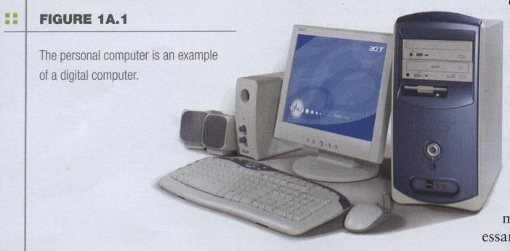
The Computer Defined
Electronic device
Converts data into information
Modern computers are digital
Two digits combine to make data (0, 1)

Slide 8
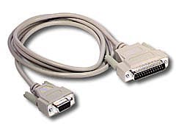
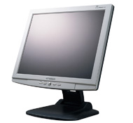
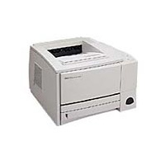
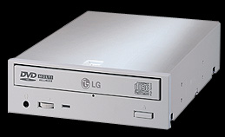
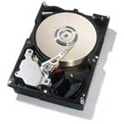
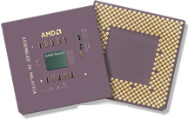
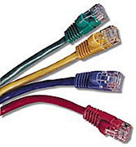
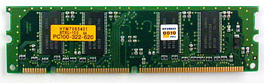
A computer is:
An electronic machine that can be programmed to accept data (input), and process it into useful information (output). Data is put in secondary storage (storage) for safekeeping or later use.
The processing of input into output is directed by the software, but performed by the hardware.
GI/GO
Notes:
8

Slide 9
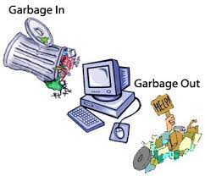
GIGO is a computer science acronym that implies bad input will result in bad output.
if a program asks for an integer and you enter a string, you may get an unexpected result.
if you try to open a binary file in a text editor, it may display unreadable content

Slide 10
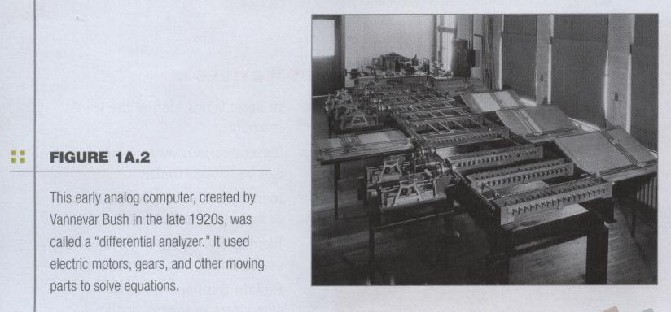
The Computer Defined
Older computers were analog
A range of values made data
Notes:
Analog computers operate on mathematical variables in the form of physical quantities that are continuously varying. For example temperature, pressure, voltages, etc.

Slide 11
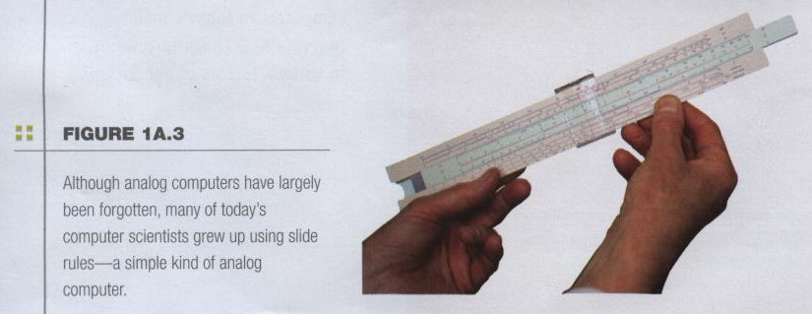
The Computer Defined
Older computers were analog
A more manageable type -- the old-fashioned slide rule

Slide 12
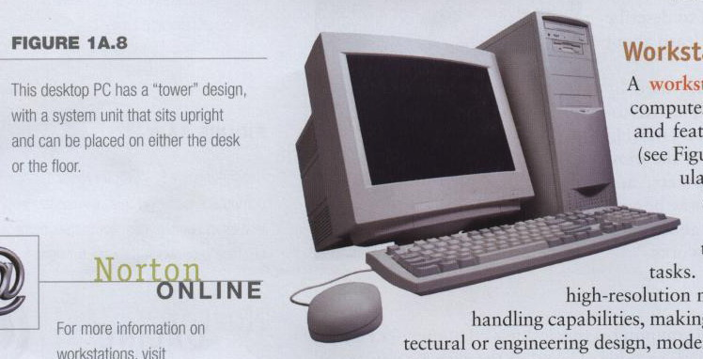
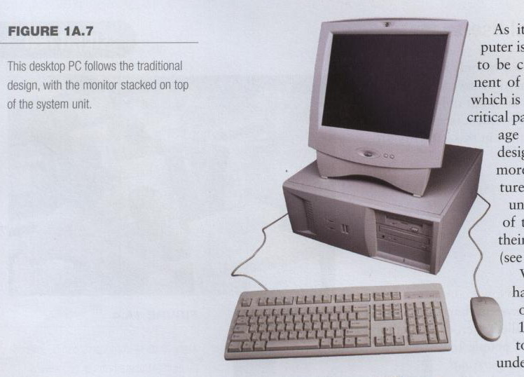
Computers for Individual Use
Desktop computers
Different design types

Slide 13
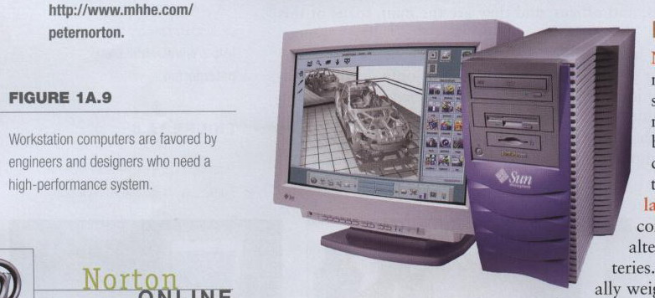
Computers for Individual Use
Workstations
Specialized computers
Optimized for science or graphics
More powerful than a desktop

Slide 14
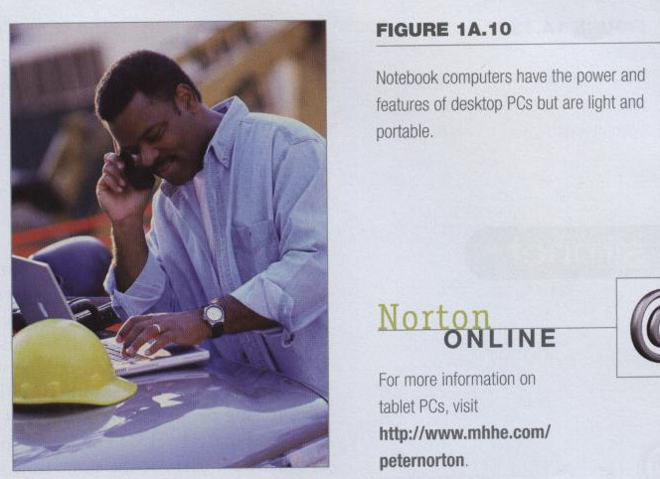
Computers for Individual Use
Notebook computers
Small portable computers
Weighs between 3 and 8 pounds
Notes:
Discussion point
Have students contrast desktop and notebook computers. Focus on the pros and cons of each type of computer.

Slide 15
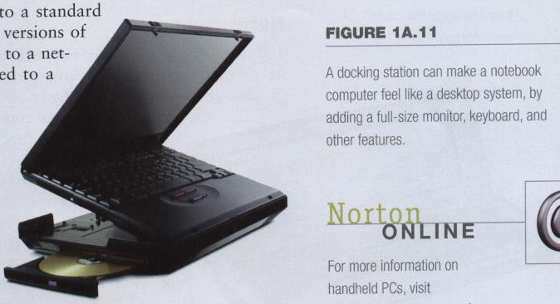
Computers for Individual Use
Notebook computers
About 8 ½ by 11 inches
Typically as powerful as a desktop
Can include a docking station

Slide 16
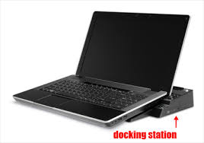
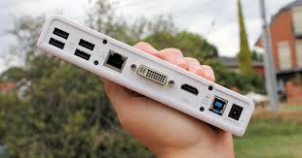
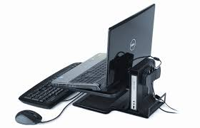
Docking station

Slide 17

Computers for Individual Use
Tablet computers
Newest development in portable computers
Input is through a pen
Run specialized versions of office products
Notes:
Teaching tip
The tablet PC was designed to simulate a piece of paper. Users interact with the tablet as if it was an unlimited paper notebook.
For more information
See www.microsoft.com/windowsxp/tabletpc/evaluation/tours/default.mspx for an example of the Tablet PC in action.

Slide 18
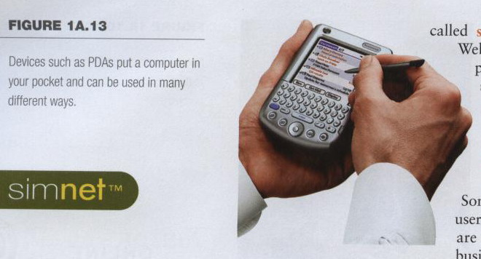
Computers for Individual Use
Handheld computers, palm computer
Very small computers
Personal Digital Assistants (PDA)
Note taking or contact management
Data can synchronize with a desktop
Notes:
Teaching tip
At this point, refer the students to the productivity tip on page 13. This tip helps the student determine what type of PC is best for them.

Slide 19
Personal digital assistant
is a term for a small, mobile, handheld device.
provides computing and information storage and retrieval capabilities for personal or business use.
often for keeping schedules.
calendars and address book information handy.

Slide 20
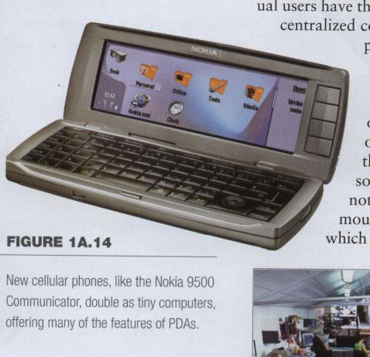
Computers for Individual Use
Smart phones
Hybrid of
cell phone
and PDA
Web surfing,
e-mail access

Slide 21
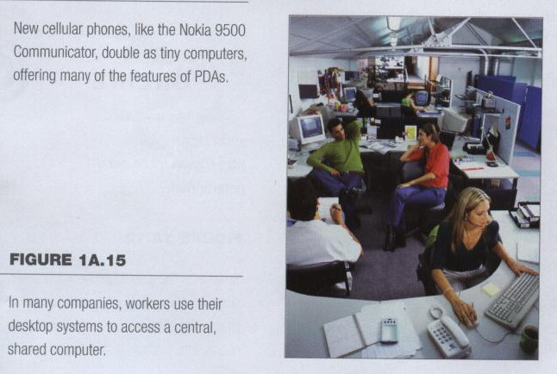
Computers for Organizations
Network servers
Centralized computer
All other computers connect

Slide 22
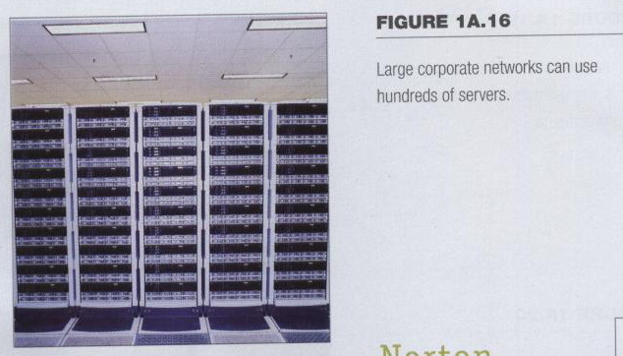
Computers for Organizations
Network servers
Provides access to network resources
Multiple servers are called server farms
Often simply a powerful desktop: Google

Slide 23
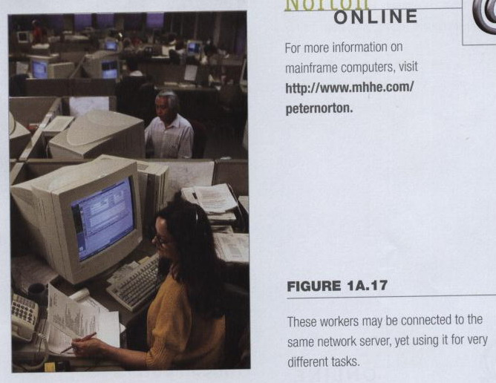
Computers for Organizations
Network servers
Flexibility to different kinds of tasks
Computers for Organizations
Computers for Organizations

Slide 24
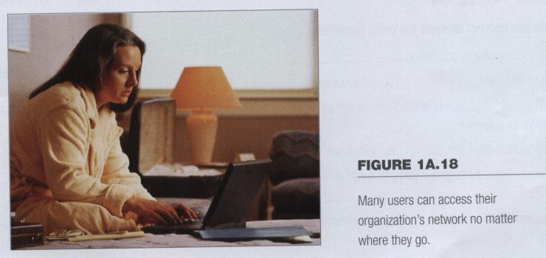
Computers for Organizations
Network servers
Users use the Internet as a means of connecting even if away from the offices.

Slide 25
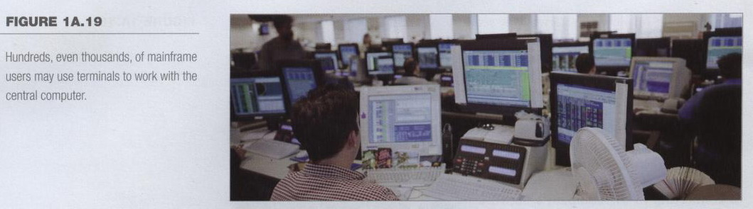
Computers for Organizations
Mainframes
Used in large organizations
Handle thousands of users
Users access through a terminal

Slide 26
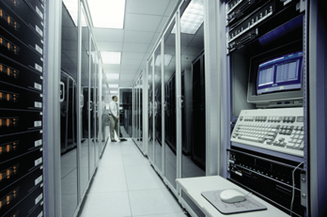
Computers for Organizations
Mainframes
Large and powerful systems

Slide 27
Computers for Organizations
Minicomputers
Called midrange computers
Power between mainframe and desktop
Handle hundreds of users
Used in smaller organizations
Users access through a terminal

Slide 28
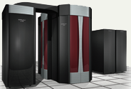
Computers for Organizations
Supercomputers
The most powerful computers made
Handle large and complex calculations
Process trillions of operations per second
Found in research organizations
Notes:
Teaching tip
Students have a hard time understanding trillions of calculations. A simple explanation is to add 1 trillion random numbers together in a second. Contrast the speed of a super computer to the fastest desktop computer advertised during the week of class.

Slide 29
Computer Units
1,000,000,000,000
(10¹²)
100,000,000,000
(10¹¹)
10 ,000, 000 ,000(10¹⁰)
1,000,000,000(10⁹)
1,000,000(10⁶)
Trillion( tera)
One Hundred Billion
Ten Billion
Billion
Mega(Million)

Slide 30
Review Questions
What is a computer?
Explain a few of the different ways in which computers can be categorized.
List six types of computers that are designed for use by a single person.
Describe the two common designs for desktop computers.
How much do notebook computers typically weigh?
List four types of computers that are designed for use by organizations, and are commonly used by multiple people at the same time.

Slide 31
Review Questions
7. Why are mainframe systems usually limited in the number of tasks they perform?
8. What is the most popular use for home computers?
9. How are computer technologies used by the military?
10. How are computer technologies being used to train surgeons?

Slide 32
Project
Open your personal computer at home and list the hardware specification as detailed as possible, including the manufacturer, product type, and serial number. List every software installed on your personal computer. For example:
PC: 友鄰
CPU: Intel Pentium 4 1.8G Hz
Motherboard: S45GMAX
SDRAM: 1GB DDR
AGP 3D/64MB SGRAM
hard disk: 260GB
flash disk drive: 1GB
monitor: Lemel 17 inch TFT-LCD, Model: LC-AE
power supply: 250W, ATX compatible
keyboard: 104 keys Chinese-English
CD-ROM drive: 52 times speed
DVD-RW drive: 6 times speed
sound blaster card:
speakers: Trois DS 621G
mouse: Logitech Optical Mouse
anti-virus software: Norton AntiVirus
anti-virus software: Trend Micro/Internet Phone
OS: Microsoft Windows XP
productivity software: Microsoft Office XP
X-Stop: pornography prevention software
…

Slide 33
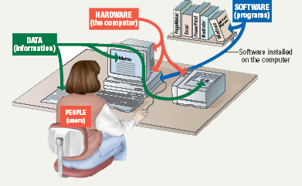
Parts of the Computer System
Computer systems have four parts
Hardware
Software
Data
User

Slide 34
Parts of the Computer System
Hardware
Mechanical devices in the computer
Anything that can be touched
Software
Tell the computer what to do
Also called a program
Thousands of programs exist
Notes:
Teaching tip
Suggest to your students that the majority of people who purchase computers do so because of software. They want to email, or type letters. Nearly every reason given to purchase a computer is based on software needs.

Slide 35
Parts of the Computer System
Data
Pieces of information
Computers organize and present data
Users
People operating the computer
Most important part
Tell the computer what to do
Notes:
Teaching tip
A good exercise to relate the importance of making data meaningful is to list some random numbers on the board. Then ask what they mean. Without a title, the numbers have no meaning. Once a title is presented, the numbers make sense.

Slide 36
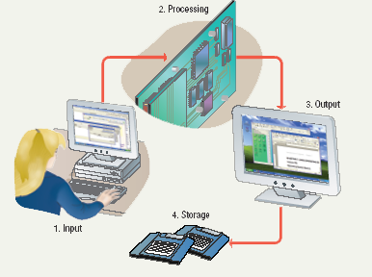
Information Processing Cycle
Steps followed to process data
Input
Processing
Output
Storage
Notes:
Teaching tip
It is helpful to walk through a simple program to demonstrate the cycle. I often use a simple arithmetic problem to show this cycle.

Slide 37
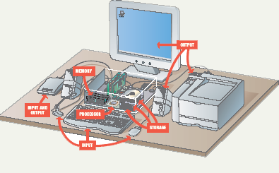
Essential Computer Hardware
Computers use the same basic hardware
Hardware categorized into four types

Slide 38
Hardware categorized into four types:
Processing devices
Memory devices
Input and output devices
Storage devices

Slide 39
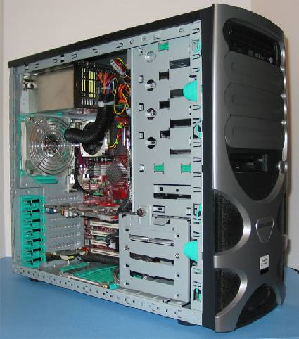
The System Unit
The System Unit houses the central processing unit, memory modules, expansion slots, and electronic circuitry as well as expansion cards that are all attached to the motherboard; along with disk drives, a fan or fans to keep it cool, and the power supply.
All other devices (monitor, keyboard, mouse, etc., are linked either directly or indirectly into the system unit.
Sources: Tom’s Hardware site: http://www.tomshardware.com
Notes:
39

Slide 40
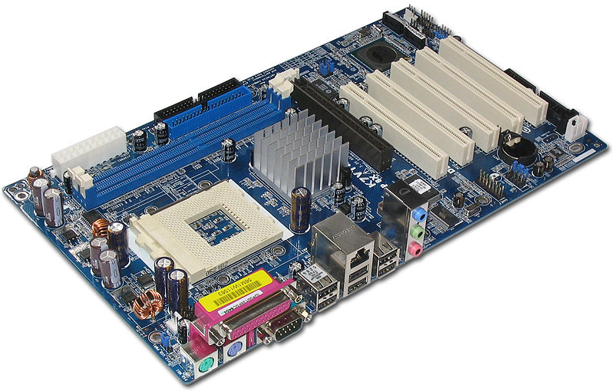
The Motherboard
Storage
Expansion slots
RAM
Peripherals
Processor

Slide 41
Essential Computer Hardware
Processing devices
Brains of the computer
Carries out instructions from the program
Manipulate the data
Most computers have several processors
Central Processing Unit (CPU)
Secondary processors
Processors made of silicon and copper
Notes:
Teaching tip
The interaction between a CPU and secondary processors is much like the interaction between a boss and subordinate. The boss tells the subordinate what to do but not necessarily how to accomplish the task. The subordinate only bothers the boss when guidance or more data is needed.

Slide 42
Essential Computer Hardware
Memory devices
Stores data or programs
Random Access Memory (RAM)
Volatile
Stores current data and programs
More RAM results in a faster system
Read Only Memory (ROM)
Permanent storage of programs
Holds the computer boot directions
Notes:
Insider information
Intel, the manufacturer of popular CPUs, originally made RAM for mainframe and minicomputers. Today Kingston is a leading RAM manufacturer.
Chapter 5 discusses ROM and the BIOS. Refer your students to this chapter if they desire more information.

Slide 43
Essential Computer Hardware
Input and output devices
Allows the user to interact
Input devices accept data
Keyboard, mouse
Output devices deliver data
Monitor, printer, speaker
Some devices are input and output
Touch screens
Notes:
Teaching tip
It is helpful to have examples of input and output devices in class. Stories of obscure input output devices are typically well received by the students.

Slide 44
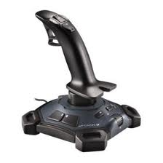
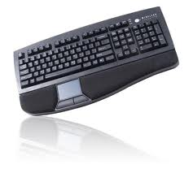
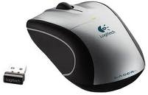
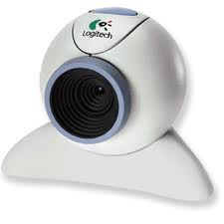
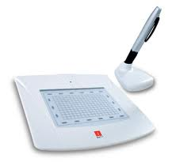
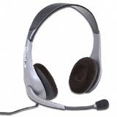
Input Devices
Any peripheral used to provide data and input signals to the computer
Keyboard
Mouse
Joystick
WebCamera
Mic. & Earphone
Digtal tablet

Slide 45
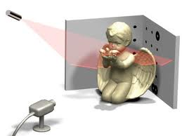
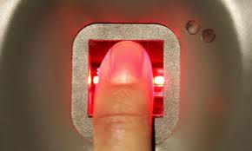
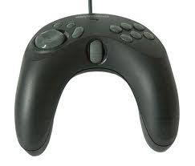
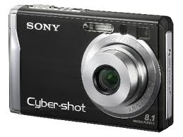
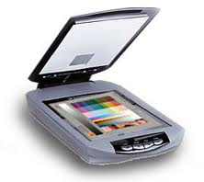
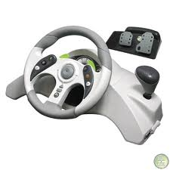
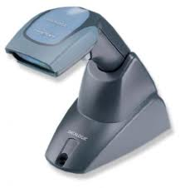
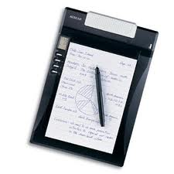
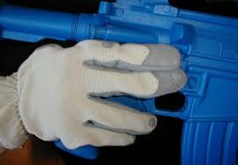
Input Devices
3-D scanner
Fingerprint scanner
Digital Camera
s
Joystick
Scanner
Wearable input gloves
Racing Wheel
Barcode Scanner
Tablet

Slide 46
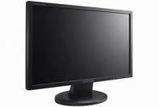




Output Devices
A Place to present processed data
Monitor
Speakers
Projector
Plotter
Laser Printer

Slide 47


Storage Vs. Memory
Memory (e.g., RAM)
The information stored is needed now
Keep the information for a shorter period of time (usually volatile)
Faster
More expensive
Low storage capacity (~1/4 of a DVD for 1 GB)
Storage (e.g., Hard disk)
The information stored is not needed immediately
The information is retained longer (non-volatile)
Slower
Cheaper
Higher storage capacity (~50 DVD’s for 200 GB)

Slide 48
Essential Computer Hardware
Storage devices
Hold data and programs permanently
Different from RAM
Magnetic storage
Floppy and hard drive
Uses a magnet to access data
Optical storage
CD and DVD drives
Uses a laser to access data
Notes:
Insider information
A new CD technology is emerging. A shorter wavelength blue laser beam is being used to burn CD’s. This allows more data to be saved on a disk. The technology is in it’s infancy but should be mature in the near future.
Chapter 11 of the text provides more detail regarding storage devices.
DVD writers are available for purchase. They have not been standardized yet. Several competing formats are vying for acceptance. Of these, the DVD+RW seems to have the strongest support.

Slide 49






Storage Devices
Tape drives
5 1/2” Floppy drive
Flash memory card
3 1/2 “ Floppy drive
USB flash drive

Slide 50




Storage Devices
Zip drives
CD/DVD/Blueray
Hard disk
Magento Optic

Slide 51
Software Runs the Machine
Tells the computer what to do
Reason people purchase computers
Two types
System software
Application software

Slide 52
Software Runs the Machine
System software
Most important software
Operating system
Windows XP
Network operating system (OS)
Windows Server 2003
Utility
Symantec AntiVirus

Slide 53
Software Runs the Machine
Application software
Accomplishes a specific task
Most common type of software
MS Word
Covers most common uses of computers

Slide 54
Computer Data
Fact with no meaning on its own
Stored using the binary number system
Data can be organized into files
Notes:
Teaching tip
Chapter 5 in the text explores data processing in greater detail.
Figure 1B.5 shows data in binary format.

Slide 55
Computer Users
Role depends on ability
Setup the system
Install software
Manage files
Maintain the system
“Userless” computers
Run with no user input
Automated systems
Notes:
Teaching tip
Most computer problems are caused by user error. Given this fact, it is fun here to teach the student the acronym PEBKAC the Problem Exists Between Keyboard And Chair. A little humor can break up the lecture monotony.

Slide 56

Devices for the Hand
Pen based input
Tablet PCs, PDA
Pen used to write data
Pen used as a pointer
Handwriting recognition
On screen keyboard
Notes:
Teaching tip
Microsoft has a demonstration of the tablet PC pen based input. Point your browser to http://www.microsoft.com/windowsxp/tabletpc/evaluation/tours/default.mspx and follow the tours.

Slide 57

Devices for the hand
Touch screens
Sensors determine where finger points
Sensors create an X,Y coordinate
Usually presents a menu to users
Found in cramped or dirty environments
Notes:
Discussion point
Discuss the information kiosks at local malls. Many offer limited Internet access. Have students discuss what could happen to the computers if the malls were to provide keyboards to the mall shoppers.

Slide 58

Devices for the hand
Game controllers
Enhances gaming experience
Provide custom input to the game
Modern controllers offer feedback
Joystick
Game pad
Notes:
Teaching tip
Microsoft’s Force Feedback joysticks vibrate. In driving games, when the player hits another car, the joystick will vibrate.

Slide 59
Optical Input Devices
Allows the computer to see input
Bar code readers
Converts bar codes to numbers
UPC code
Computer find number in a database
Works by reflecting light
Amount of reflected light indicates number
Notes:
Insider information
For more information on the UPC code and a searchable database, visit http://www.upcdatabase.com/. A working UPC is 071662000240, which represents a 24 count box of Crayola Crayons.

Slide 60
Optical Input Devices
Image scanners
Converts printed media into electronic
Reflects light off of the image
Sensors read the intensity
Filters determine color depths
Notes:
Teaching tip
Spend a few minutes here discussing computer screen colors. A good website to look at colors is http://www.radok.com/web-safe-colors_rgb.html. To demonstrate how computers generate color, use the custom color creator in Paint.

Slide 61
Optical input devices
Optical character recognition (OCR)
Converts scanned text into editable text
Each letter is scanned
Letters are compared to known letters
Best match is entered into document
Rarely 100% accurate
Notes:
Teaching tip
Many companies ask for a plaintext resume. This is a resume, typed in Courier or other easy to read font, with no formatting. The intent is to allow the company to scan the resume for future searching. OCR technology makes this possible. For more information, see the website http://www.quintcareers.com/scannable_resumes.html.

Slide 62
Audiovisual Input Devices
Microphones
Used to record speech
Speech recognition
“Understands” human speech
Allows dictation or control of computer
Matches spoken sound to known phonemes
Enters best match into document
Notes:
Insider information
Two common products are IBM’s Via Voice and Scansoft Dragon NaturallySpeaking. More information for ViaVoice can be found at http://www-306.ibm.com/software/voice/viavoice/. More information regarding Dragon is located at http://www.scansoft.com/naturallyspeaking/.

Slide 63

Audiovisual Input Devices
Musical Instrument Digital Interface
MIDI
Connects musical instruments to computer
Digital recording or playback of music
Musicians can produce professional results

Slide 64

Audiovisual Input Devices
Digital cameras
Captures images electronically
No film is needed
Image is stored as a JPG file
Memory cards store the images
Used in a variety of professions

Slide 65
Transforming Data Into Information

Slide 66
How Computers Represent Data
Number systems
A manner of counting
Several different number systems exist
Decimal number system
Used by humans to count
Contains ten distinct digits
Digits combine to make larger numbers

Slide 67
How Computers Represent Data
Binary number system
Used by computers to count
Two distinct digits, 0 and 1
0 and 1 combine to make numbers
Notes:
Teaching Tip
Table 5A.1 on page 187 provides the first 17 binary numbers and their decimal equivalent. A fun exercise is to teach the students to count in binary on their fingers.

Slide 68

How Computers Represent Data
Bits and bytes
Binary numbers are made of bits
Bit represents a switch
A byte is 8 bits
Byte represents one character

Slide 69
How Computers Represent Data
Text codes
Converts letters into binary
Standard codes necessary for data transfer
ASCII
American English symbols
Extended ASCII
Graphics and other symbols
Unicode
All languages on the planet
Notes:
Insider information
Windows XP, Mac OS X and newer flavors of Linux are fully Unicode compatible.

Slide 70


Slide 71
How Computers Process Data
The CPU
Central Processing Unit
Brain of the computer
Control unit
Controls resources in computer
Instruction set
Arithmetic logic unit
Simple math operations
Registers
Notes:
Teaching tip
Table 5A.4 on page 190 lists the operations handled by the common ALU.

Slide 72
How Computers Process Data
Machine cycles
Steps by CPU to process data
Instruction cycle
CPU gets the instruction
Execution cycle
CPU performs the instruction
Billions of cycles per second
Pipelining processes more data
Multitasking allows multiple instructions
Notes:
Insider information
More pipelines mean a faster and more efficient CPU. The current fastest CPU on the market, the Apple G5 has 80 pipelines!

Slide 73

How Computers Process Data
Memory
Stores open programs and data
Small chips on the motherboard
More memory makes a computer faster

Slide 74
How Computers Process Data
Nonvolatile memory
Holds data when power is off
Read Only Memory (ROM)
Basic Input Output System (BIOS)
Power On Self Test (POST)
Notes:
Teaching tip
If you are in a computer lab, spend a few minutes exploring your BIOS. Demonstrate what happens when values are adjusted. Walk through a POST check. Unplug a device and generate POST errors. Be sure to reset everything before moving on with the lecture!

Slide 75
Basic Input/Output System
Every computer with a motherboard includes a special chip referred to as the BIOS.
The BIOS includes instructions on how to load basic computer hardware.
The BIOS has 4 main functions:
POST - Test computer hardware insuring hardware is properly functioning before starting process of loading Operating System.
Bootstrap Loader - Process of locating the operating system. If capable Operating system located BIOS will pass the control to it.
BIOS - Software / Drivers which interfaces between the operating system and your hardware. When running DOS or Windows you are using complete BIOS support.
CMOS Setup - Configuration program. Which allows you to configure hardware settings including system settings such as computer passwords, time, and date.

Slide 76
How Computers Process Data
Flash memory
Data is stored using physical switches
Special form of nonvolatile memory
Camera cards, USB key chains
(information isn’t erased when the power is off, like it is with ROM. flash memory isn’t as fast as RAM)

Slide 77
How Computers Process Data
Volatile memory
Requires power to hold data
Random Access Memory (RAM)
Data in RAM has an address
CPU reads data using the address
CPU can read any address
Notes:
Teaching tip
One of the most commonly asked questions is “How do I speed up my computer”. The simplest answer is to add RAM. The Productivity Tip on page 200 provides some guidelines when to add RAM.

Slide 78

Components affecting Speed

Slide 79
Affecting Processing Speed
Registers
Number of bits processor can handle
Word size
Larger indicates more powerful computer
Increase by purchasing new CPU
RAM | Register
RAM is much slower than registers | registers are temporary storage in the CPU that holds the data the processor is currently working on
Memory or RAM, is located external to the CPU. RAM holds the program instructions and the data the program requires.

Slide 80
Affecting Processing Speed
Virtual RAM
Computer is out of actual RAM
File that emulates RAM
Computer swaps data to virtual RAM
Least recently used data is moved
Virtual memory, also known as the swap file, uses part of your hard drive to effectively expand your RAM, allowing you to run more programs than it could otherwise handle

Slide 81
Affecting Processing Speed
The computer’s internal clock
the clock refers to a microchip that regulates the timing and speed of all computer functions.
The speed of a computer processor is measured in clock speed
clock speed is the speed that the microprocessor executes each instruction
The CPU requires a fixed number of clock ticks, or cycles, to execute each instruction.
Quartz crystal
Every tick causes a cycle
Speeds measured in Hertz (Hz)
Modern machines use Giga Hertz (GHz)
Notes:
Teaching tip
Spend a little time here discussing over clocking. Over clocking causes the computer to run faster than designed. Possibly, you have students that can share stories of over clocking.

Slide 82
Affecting Processing Speed
The bus
Electronic pathway between components
Expansion bus connects to peripherals
System bus connects CPU and RAM
Bus width is measured in bits
Speed is tied to the clock

Slide 83
Affecting Processing Speed
External bus standards
Industry Standard Architecture (ISA)
Local bus
Peripheral control interface
Accelerated graphics port
Universal serial bus
IEEE 1394 (FireWire)
PC Card

Slide 84
Affecting Processing Speed
Peripheral control interface (PCI)
Connects modems and sound cards
Found in most modern computers

Slide 85
Affecting Processing Speed
Accelerated Graphics Port (AGP)
Connects video card to motherboard
Extremely fast bus
Found in all modern computers

Slide 86
Affecting Processing Speed
Universal Serial Bus (USB)
Connects external devices
Hot swappable
a hot swappable device a peripheral or component that can be removed or added while a computer is running
Allows up to 127 devices
Cameras, printers, and scanners

Slide 87

Affecting Processing Speed
PC Card
A PC Card (previously known as a PCMCIA card) is a credit card-size memory or I/O device that fits into a personal computer, usually a notebook or laptop computer.
Used on laptops
Hot swappable
Devices are the size of a credit card

Slide 88
Affecting Processing Speed
Cache memory
Very fast memory
Holds common or recently used data
Speeds up computer processing
Most computers have several caches
L1 holds recently used data
L2 holds upcoming data
L3 holds possible upcoming data

Slide 89
Modern CPUs

Slide 90
A Look Inside The Processor
Architecture
Determines
Location of CPU parts
Bit size
Number of registers
Pipelines
Main difference between CPUs
Notes:
Teaching tip
Bit size tends to confuse students. A simple example clarifies the importance of bit size. Consider two equal computers, one has a 32-bit processor, the other a 64 bit processor. With all other items equal, the 64-bit processor will handle twice the data the 32 bit processor handles. This is like driving a car at 55 Mph then doubling it to 110 Mph.

Slide 91
Consider Processor as an Engine of a vehicle, when it coupled with steering(Control Unit), Fuel Tank(Memory) and a person driving it (ALU) it becomes a CPU.
Thus, to summarize, Processor is PART of the CPU that does computational tasks, A CPU can have more than one Processor, a computing system can have more than One CPU.

Slide 92
Microcomputer
A microcomputer is a complete computer on a smaller scale and is generally a synonym for the more common term, personal computer or PC

Slide 93

Microcomputer Processors
Intel
Leading manufacturer of processors
Intel 4004 was worlds first microprocessor
microprocessor -an integrated circuit that contains all the functions of a central processing unit of a computer.
IBM PC powered by Intel 8086
Current processors
Centrino
Itanium
Pentium IV
Xeon
Notes:
Teaching Tip
Table 5B.1 on page 208 lists several of Intel’s modern processors. A new addition is the Centrino Mobile processor family, designed for laptops with wireless connections.

Slide 94

Microcomputer Processors
Advanced Micro Devices (AMD)
Main competitor to Intel
Originally produced budget products
Current products outperform Intel
Current processors
Sempron
Athlon FX 64
Athlon XP
Notes:
Teaching Tip
Table 5B.2 on page 209 lists most of the modern AMD processors. A new addition is the Sempron processor, aimed at beating the Intel Celeron and Centrino Mobile processors.

Slide 95
Microcomputer Processors
Freescale
A subsidiary of Motorola
Co-developed the Apple G4 PowerPC
Currently focuses on the Linux market

Slide 96
Microcomputer Processors
IBM
Historically manufactured mainframes
Partnered with Apple to develop G5
First consumer 64 bit chip

Slide 97
Comparing Processors
Speed of processor
Size of cache
Number of registers
Bit size
Speed of Front side bus
Notes:
Teaching Tip
Table 5B.3 on page 210 lists the specifications for three powerful processors.

Slide 98
Advanced Processor Topics
RISC processors
Reduced Instruction Set Computing
Smaller instruction sets
May process data faster
PowerPC and G5

Slide 99
Advanced Processor Topics
Parallel Processing
Multiple processors in a system
Symmetric Multiple Processing
Number of processors is a power of 2
Massively Parallel Processing
Thousands of processors
Mainframes and super computers
Notes:
Discussion point
Parallel processing is not always as fast as it claims. Make some analogies to multiple workers painting a room. Let the students contribute stories. End the discussion with comments regarding Fred Brook’s statement “No matter how many women are assigned to the task, it still takes nine months to have a baby”.

Slide 100
Extending The Processors Power
Standard computer ports
Keyboard and mouse ports
USB ports
Parallel
Network
Modem
Audio
Serial
Video
Notes:
Teaching Tip
Contrast the network and modem port. Point out that the modem port is smaller than the network port. Modems use a 4-wire cable while network ports use an 8-wire cable.

Slide 101

Standard Computer Ports

Slide 102
Extending The Processors Power
Serial and parallel ports
Connect to printers or modems
Parallel ports move bits simultaneously
Made of 8 – 32 wires
Internal busses are parallel
Serial ports move one bit
Lower data flow than parallel
Requires control wires
UART converts from serial to parallel
A universal asynchronous receiver/transmitter (UART) is a computer hardware device for asynchronous serial communication in which the data format and transmission speeds are configurable.
Notes:
Teaching tip
Figure 5B.9 on page 213 shows data flowing through a serial interface. Similarly, Figure 5B.10 on page 214 shows data flowing through a parallel interface.

Slide 103

Serial Communications

Slide 104

Parallel Communications

Slide 105

Extending The Processors Power
SCSI
Small Computer System Interface
Supports dozens of devices
External devices daisy chain
Fast hard drives and CD-ROMs
daisy chain is a wiring scheme in which multiple devices are wired together in sequence or
Notes:
Insider information
SCSI is typically found on network servers and high-end workstations. SCSI is unique among the buses discussed so far because it does not use CPU power to control the devices.

Slide 106
Extending The Processors Power
USB
Universal Serial Bus
Most popular external bus
Supports up to 127 devices
Hot swappable

Slide 107
Extending the Processors Power
FireWire
IEEE 1384
Cameras and video equipment
Hot swappable
Port is very expensive

Slide 108

Extending the Processors Power
Expansion slots and boards
Allows users to configure the machine
Slots allow the addition of new devices
Devices are stored on cards
Computer must be off before inserting
Notes:
Teaching tip
It is helpful to have several cards on hand for demonstration. If possible, use a student to show the technique for inserting a card.

Slide 109
Extending the Processors Power
PC Cards
Expansion bus for laptops
PCMCIA
Hot swappable
Small card size
Three types, I, II and III
Type II is most common

Slide 110
Extending the Processors Power
Plug and play
New hardware detected automatically
Prompts to install drivers
Non-technical users can install devices
Notes:
Insider Information
Plug and play was introduced by Apple Computers.

Slide 111
Operating System Basics

Slide 112
Operating System
Like the brain the OS manages the computer
A program that manages the computer hardware
Provides services for application software
Acts as an intermediary between a user and the computer hardware
Without OS, no application program will run

Slide 113
Other Operating System Definitions
Resource allocator – manages and allocates resources.
Control program – controls the execution of user programs and operations of I/O devices .
Kernel – the one program running at all times (all else being application programs).
Notes:
Link to brain
Brain says pick hammer
-you use the hand -resource allocation
-Bang the nail
-use hammer to execute action
-controls prog, execution, I/O
-Brain is always running
-else dead/coma
-kernel always running/suspended

Slide 114

Abstract View of a Comp. System
Silberschatz

Slide 115
Operating System ...
Provides the means for proper use of the resources available
Like a government, it performs no useful function by itself. It provides an environment within which other programs can do useful work

Slide 116
Functions of Operating Systems
Provide a user interface
Run programs
Manage hardware devices
Organized file storage
Notes:
Teaching Tip
File and folder storage is covered in chapter 6.

Slide 117
One OS for all Systems ?
Different systems exist

Slide 118
Types of Operating Systems
Real-time operating system
Very fast small OS
Built into a device
Respond quickly to user input
MP3 players, Medical devices

Slide 119

Real Time Systems

Slide 120
Types of Operating Systems
Single user/Single tasking OS
One user works on the system
Performs one task at a time
MS-DOS and Palm OS
Take up little space on disk
Run on inexpensive computers

Slide 121
Types of Operating Systems
Single user/Multitasking OS
User performs many tasks at once
Most common form of OS
Windows XP and OS X
Require expensive computers
Tend to be complex
Notes:
Teaching tip
It is true that multi-tasking operating systems are complex. However both XP and OS X make the multitasking process painless for the user.

Slide 122
Types of Operating Systems
Multi user/Multitasking OS
Many users connect to one computer
Each user has a unique session
UNIX, Linux, and VMS
Maintenance can be easy
Requires a powerful computer
Notes:
Teaching tip
Multi-user Multitasking OS's are found on supercomputers, mainframes and minicomputers. Through Linux, a PC can also support user sessions and terminal connections.

Slide 123

Multi user/Multi tasking OS

Slide 124
Providing a User Interface
User interface
How a user interacts with a computer
Require different skill sets

Slide 125
Providing a User Interface
Graphical user interface (GUI)
Most common interface
Windows, OS X, Gnome, KDE
Uses a mouse to control objects
Uses a desktop metaphor
Shortcuts open programs or documents
Open documents have additional objects
Task switching
Dialog boxes allow directed input
Notes:
Insider information
The first commercial GUI was the Xerox Star.
Teaching Tip
There are several types of dialog boxes. Any errors are displayed in a dialog box. This box is system modal - it requires a response before returning to the OS. Save and print boxes are application modal - The box must be dealt with before returning to the application. However, other OS tasks can be performed.

Slide 126

Graphical User Interface

Slide 127
Providing a User Interface
Command line interfaces
Older interface
DOS, Linux, UNIX
User types commands at a prompt
User must remember all commands
Included in all GUIs
Notes:
Teaching tip
Demonstrate the command line interface in Windows by running cmd. In the command line interface use ping and ipconfig as commands that cannot be run in the GUI.

Slide 128

Command Line Interface

Slide 129
Running Programs
Many different applications supported
System call
Provides consistent access to OS features
Share information between programs
Copy and paste
Object Linking and Embedding
Notes:
Teaching tip
Most students have never encountered a link. I use MS Excel and MS Word to link. Create and save a simple spreadsheet in Excel. Copy the spreadsheet to the clipboard. Open MS Word and paste-link the spreadsheet. Save the MS Word document. Then change and save the spreadsheet in Excel. The word document is automatically updated.

Slide 130
Managing Hardware
Programs need to access hardware
Interrupts
CPU is stopped
Hardware device is accessed
Device drivers control the hardware
Notes:
Discussion point
The mouse uses an interrupt. Many users will move the mouse while waiting for the CPU to finish a task. What does moving the mouse do to the current process?
Teaching tip
Discuss what can happen when the wrong driver is installed on a computer.

Slide 131
Organizing Files and Folders
Organized storage
Long file names
Folders can be created and nested
All storage devices work consistently

Slide 132
Enhancing an OS
Utilities
Provide services not included with OS
Goes beyond the four functions
Firewall, anti-virus and compression
Prices vary
Notes:
Discussion point
With Windows XP and SP2, Microsoft has included a firewall and pop-up blocker both typically considered utility software. In the near future, the core services provided by an OS may include security features.

Slide 133
Enhancing an OS
Backup software
Archives files onto removable media
Ensures data integrity
Most OS include a backup package
Many third party packages exist

Slide 134

Backup Software

Slide 135
Enhancing an OS
Anti-virus software
Crucial utility
Finds, blocks and removes viruses
Must be updated regularly
McAfee and Norton Anti-Virus

Slide 136
Enhancing an OS
Firewall
Crucial utility
Protects your computer from intruders
Makes computer invisible to hackers
Zone Labs is a home firewall
Cisco sells hardware firewalls
Notes:
Teaching tip
Windows XP includes a firewall. Service pack 2 will turn this firewall on by default. To test your computer’s security visit www.grc.com and run the various Shields Up! tests

Slide 137
Enhancing an OS
Intrusion detection
Often part of a firewall package
Announces attempts to breach security
Snort is a Linux based package

Slide 138

Enhancing an OS
Screen savers
Crucial utility for command line systems
Prevents burn in
Merely fun for GUI systems
Screen saver decorates idle screens

Slide 139
Project
Login to Unix or Linux workstation and run latex.
script t
whoami
man passwd
passwd
w
finger fuh
finger @linux3
df
du
ls
date
ps
exit
more t

Slide 140
script is a standard Unix command that records a script of your interaction with the Unix system.
W-column width
finger is a program you can use to find information about computer users. It usually lists the login name, the full name, and possibly other details about the user
df (abbreviation for disk free) is a standard Unix command used to display the amount of available disk space for file systems on which the invoking user has appropriate read access

Slide 141
“du” (Disk Usage) is a standard Unix/Linux command, used to check the information of disk usage of files and directories on a machine. du-h filename: human readable format.
ps-: report a snapshot of the current processes.
more is a filter for paging through text one screen at a time.

Slide 142
Survey of PC and Network Operating Systems

Slide 143
PC Operating Systems
Microsoft Windows is the most popular
Installed more than other OS combined
Installed on about 95% of computers
Apple and Linux represent the other 5%
Notes:
Teaching tip
Www.w3schools.com/browsers/browsers_stats.asp provides a neutral look at OS statistics. Refer to this page as you lecture. Visit www.wordiq.com/definition/Microsoft_Windows for an excellent timeline and description of Windows operating systems.

Slide 144
PC Operating Systems
DOS
Disk Operating System
Single user single-tasking OS
Command line interface
16-bit OS
Powerful
Fast
Supports legacy applications
a legacy system is an old method, technology, computer system.
Notes:
Teaching tip
Students often fail to see the value in older OS or applications. As an example, a metal fabrication plant in Pittsburgh PA is still using a program written in the early 70’s that calculates metal temperatures.

Slide 145

DOS Application

Slide 146
PC Operating Systems
Windows NT
Designed for a powerful system
32-bit OS
Very stable
Windows NT Workstation
Single user multi tasking OS
Windows NT Server
Multi user multi tasking OS
Network operating system

Slide 147
PC Operating Systems
Windows 9x
95, 98, and Millennium Edition (Me)
32-bit OS
Supported 16-bit programs well
Very pretty not stable OS
Still found in large corporations
95 introduced the Start button
98 introduced active desktop
Me improved multimedia software

Slide 148
PC Operating Systems
Windows 2000
Look of 9x with NT stability
Optimized for office and developers
Application software ran very well
Entertainment software ran very poorly
Notes:
Discussion point
There are many computer professionals that say that Windows 2000 was the first stable Microsoft product. Engage your class in a discussion regarding a software developer’s obligation to create stable products.

Slide 149
PC Operating Systems
Windows XP
Microsoft’s newest desktop product
Different look from 2000
Many different versions
Digital multimedia support was enhanced
Communications was enhanced
Mobile computing became a priority
Notes:
Teaching tip
At press time, the 64 bit version of XP was still in the late beta stage. More information can be found at www.microsoft.com/presspass/press/2003/sep03/09-23athlon64betapr.asp.

Slide 150
PC Operating Systems
UNIX
Runs on all computer types
32- or 64-bit
Very stable and fast
Command-line interface
Can cost thousands of dollars

Slide 151
PC Operating Systems
Linux
Free or inexpensive version of UNIX
32-bit OS
Very stable and fast
Most flavors are open source
X Windows GUI
Command line interface is available

Slide 152

Linux Desktop

Slide 153
PC Operating Systems
Macintosh operating systems
OS X
Based on FreeBSD Linux
Very stable and easy to configure
Only runs on Mac hardware
Notes:
Teaching tip
OS X versions change often. Keep track of the most current and present this to the class. Visit www.apple.com/macosx/ to keep up to date. At press time the latest version was 10.4 Tiger.

Slide 154

OS X Desktop

Slide 155
NOS Features
Network operating system
Fast and stable
Runs on servers
Multi-user and multitasking OS
32- or 64-bit

Slide 156
NOS Features
File and print sharing
Users access the same files
Hundreds of users use a printer
Different OS can interact

Slide 157
NOS Features
Data integrity
Backups copies data onto tape
RAID copies data onto other drives
Redundant Array of Inexpensive Disks
Relies on two or more hard drives
May speed access to data

Slide 158
NOS Features
Data security
Access to data can be restricted
Access to server resources is controlled
Audits can be kept
Notes:
Teaching tip
Tell your students what NOS your school uses.

Slide 159
Networking Operating Systems
NT Server
Same core as NT Workstation
Security added
Multi user capability added
RAID support included

Slide 160
Networking Operating Systems
Windows 2000 Server
Same technology as 2000 workstation
Active Directory (AD)
Central database of server resources
Simplifies network management
Distributed programs supported
Server Standard Edition
Advanced Server Edition
Data Center Edition
Notes:
Teaching tip
Spend some time describing how distributed applications can reduce network needs.

Slide 161
Networking Operating Systems
Windows 2003 Server
Designed to compete with UNIX
XP like interface
Better support for XP computers
MS .NET framework supported
Distributed programs are supported
Server Standard Edition
Data Center Edition

Slide 162
Networking Operating Systems
UNIX for servers
Oldest NOS in widespread use
Stable secure and fast
Main OS for Internet and Web
Large organizations depend on UNIX

Slide 163
Networking Operating Systems
Linux for servers
Popular in small businesses
Stable, fast and inexpensive
Linux’s popularity is growing
Notes:
Insider information
The email service hotmail was originally hosted on Linux servers. Microsoft purchased Hotmail and moved it to Windows servers. It took Microsoft nearly a year to make Hotmail work as well on Windows as it did on Linux.

Slide 164
Embedded Operating Systems
Devices have EOS built in
Cell phones, PDAs, medical equipment
Stable and fast

Slide 165
Embedded Operating Systems
Windows XP embedded
Based on Windows XP
Customized for each device

Slide 166
Embedded Operating Systems
Windows CE
Not based on a desktop OS
Customized for each device
PDA and cell phones
Microsoft Automotive will run in cars
Notes:
Teaching tip
Have a little fun with this one. Windows CE has the unfortunate and unofficial shortcut name of WinCE.

Slide 167

Embedded Operating Systems
Palm OS
Standard on Palm PDA
First PDA OS for consumers
Can be found on cell phones

Slide 168
Embedded Operating Systems
Pocket PC
Developed to compete with Palm
Not customizable
Interacts securely with business networks
Can control PCs through PC

Slide 169
Embedded Operating Systems
Symbian
Found in smart cell phones
Games, Instant Messaging, Internet
Full color display

Slide 170
Programming Languages and the Programming Process

Slide 171
Programming Languages
Communicate with the computer
Understood by human and machine
Languages
Lower level language (closer to machine)
Higher level language (closer to humans)

Slide 172
Programming Languages ...
Machine Languages (1st Generation)
Assembly Languages (2nd Generation)
Procedural Languages (3rd Generation)
Problem Oriented Languages (4th Generation)
Natural Languages (5th Generation)

Slide 173
Machine Languages
Machine knows two things, 1 & 0
All instructions in terms of ones and zeros
5x4 = 00110101 00101010 00110100
a=5
b=10
c=a*b
01100001 00111101 00110101 00001101 00001010 01100010 00111101 00110001 00110000 00001101 00001010 01100011 00111101 01100001 00101010 01100010

Slide 174
Machine Language
Advangtage
Execution very fast and efficient
Disadvatages
Not easy to encode programs
No standard machine language
Machine dependent - will not easily run on another machine

Slide 175

Language Categories
Second generation languages
Assembly languages
Statements that represent machine code
Code converted by an assembler
Still used to optimize video games

Slide 176
Assembly Language
Reduce program complexity
Symbolic language using mnemonic codes
Codes replacing ones and zeros
Does not replace machine language
Assembly code converted into machine lang.
One line of assembly code converted to one/many lines of machine code

Slide 177
Assembly Language
Advantages
More standardized & easier to use
Operates efficiently (not as efficient as machine language code)
Easier to debug
Disadvantages
Very lengthy programs
Complex
Machine dependent
Start Move N, R1
Move N2, R2
CLR R0
Loop Add (R2), R0
Inc R2
Dec R1
BGTZ loop
Move R0, sum
Return

Slide 178
High Level Languages
All languages above assembly language
Procedure oriented Languages (3rd Gen.)
General purpose language
Express a logic
Solve a variety of problems
e.g. Pascal, BASIC, FORTRAN, COBOL
Advantages | Disadvantages
English like statements | Executes more slowly
Easy to understand and modify
Machine independent

Slide 179
Language Categories
Third generation languages (3GL)
First higher level language
Supports structured and OOP
Code is reusable
Code is portable
Typically written in an IDE
C/C++ creates games and applications
Java creates web applets
ActiveX creates Web and Windows applets

Slide 180
High Level Languages ...
Problem oriented languages (4th Gen.)
Solve specific problems or develop specific applications
PC Application software
Query languages & report generators
Application generators

Slide 181
Language Categories
Fourth generation languages (4GL)
Easier to use than 3GL
Coded in a visual IDE
Tools reduce the amount of code
Object oriented programming
Microsoft .Net is a language
Dream Weaver is an 4GL IDE

Slide 182
High Level Languages ...
Natural language (5th Gen.)
Make man-machine interface humanlike
Simulate learning process
LISP and PROLOG

Slide 183
Programming Languages
Used to generate source code
Avoids using machine code
Have strict rules of syntax
Symbols and punctuation have meaning
Spelling must be exact
Code is converted into machine language
Notes:
Insider information
Older languages such as COBOL and Fortran actually required developers to place different coding statements in different columns on the screen.

Slide 184
Interpreter
Spanish PM talking to Japanese PM
Dumb machine, knows only 1 & 0
Interprets the high level language
Interprets line by line
Converts each line of code just before execution
Executes program line immediately

Slide 185
Interpreter ...
Converts to intermediate level language machine can understand and executes
No object code is stored
One line executed several times, them converted to machine language each time
Delay
Example BASIC, Perl, MATLAB, Python, etc..

Slide 186

UN Assembly ...

Slide 187
Compiler ...
Translate source code into object code/machine language
Look at entire source code, collect and reorganize instructions
Fast
Better than interpreted languages
Executed faster and more efficiently once object code is obtained
Many compilers exist for same language
Example C, FORTRAN, COBOL

Slide 188

Microsoft.NET

Slide 189
WWW Development Languages
Markup languages
Describe how the text is formatted
Hyper Text Markup Language (HTML)
Basis of all web pages
Defines web structure using tags
Easy to learn and use
Created with a text editor

Slide 190
WWW Development Languages
Extensible Markup Language (XML)
Stores data in a readable format
Looks like HTML
Allows developers to create tags
Depends on HTML for formatting

Slide 191

XML

Slide 192
WWW Development Languages
Extensible HTML (XHTML)
Newer version of HTML
Stricter rules
Based on XML rules
Notes:
Teaching tip
Be sure to emphasize that all web technologies at some point need HTML or XHTML to present data in a browser.

Slide 193
WWW Development Languages
Extensible Style Sheet Language (XSL)
Format and displays XML documents
Rules that dictate formatting
Create a standard web page

Slide 194
WWW Development Languages
Extensible HTML Mobile Profile
XHTML MP
Initially Wireless Markup Language (WML)
Creates pages viewable on a handheld

Slide 195
WWW Development Languages
Cascading Style Sheets (CSS)
Format HTML, XHTML and XSL
Applies consistent formatting to all pages
Notes:
Teaching tip
Students wishing to learn about the web technologies should visit www.w3schools.com. W3schools.com offers several free tutorials covering nearly every mainstream web technology.

Slide 196
WWW Development Languages
Web authoring environments
Reduces tedium for creating pages
Tools that simplify web site creation
Macromedia Dream weaver
Simplifies large sites
CSS support is exceptional
Microsoft FrontPage simplifies large sites
Macromedia Flash creates web animations
Notes:
Teaching tip
For a fun example of what Flash can do, check out www.homestarrunner.com and watch the exploits of Strong Bad.

Slide 197
WWW Development Languages
Scripting languages
Create dynamic web pages
Change based on user input
HTML can create static pages
Page is generated as needed

Slide 198

WWW Development Languages
JavaScript
Developed by Netscape
Works inside of HTML
Page verification and simple animation
Based on Java

Slide 199
WWW Development Languages
Active Server Pages (ASP)
Developed by Microsoft
Based on Visual Basic
Good at connecting to Microsoft databases
Runs only on Microsoft servers

Slide 200
WWW Development Languages
Perl
Old UNIX language
Found on all Windows and Linux servers
Excellent web scripting language

Slide 201
WWW Development Languages
Hypertext Pre-Processor (PHP)
Especially good at connecting to MySQL
Very popular language
Runs on UNIX and Windows

